Slide 1


Slide 2
How I spend my Winter Holidays
Sadaf saleem. I’m from Sargodha,Pakistan. I have been the traveller since my childhood. My mom and dad are my travel inspiration. So whenever we got holidays, we go to travel on different beautiful places.

Slide 3
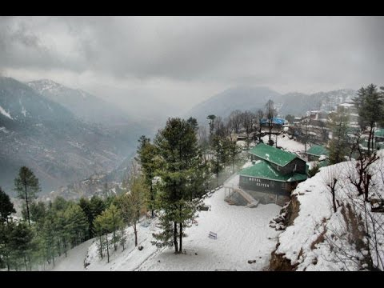
The most unsual vacation experience was my trip to muree. It was my father idea to go to trip to his birth place since he left in 1955. the emotion expressed is something that I will never forget.

Slide 4
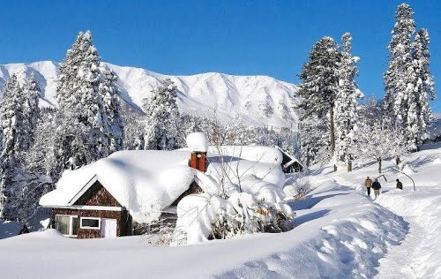
We there lived in our fathers old house where he likes to spend his childhood. We and my family friend enjoyed these days by showing love with bonefire. Here my cousin sing a song and our parents made BBQ for us childs.

Slide 5
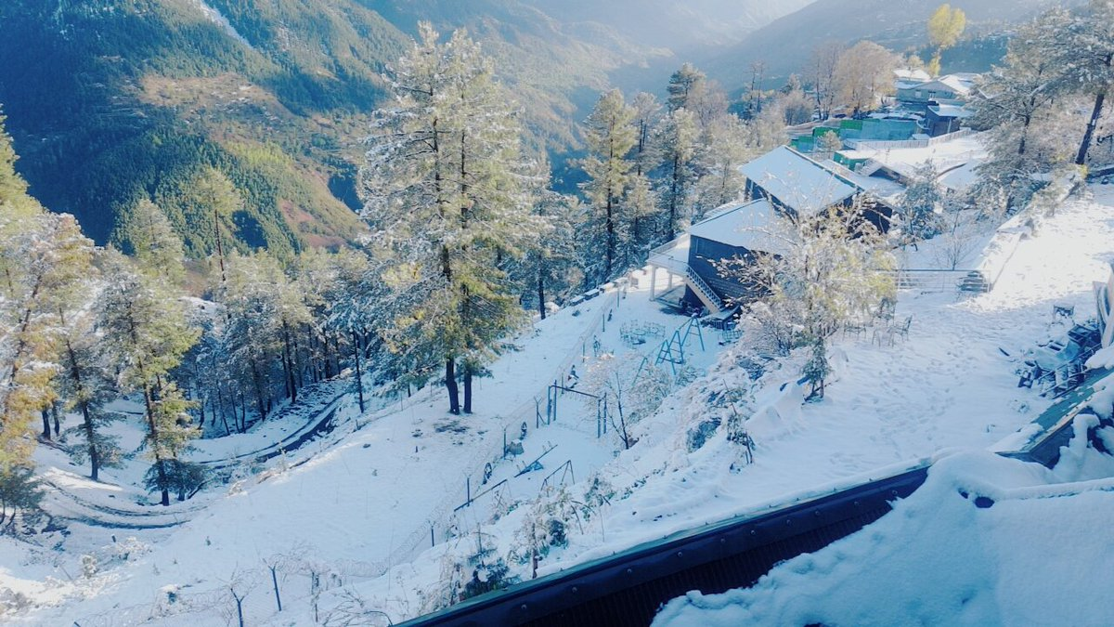
There I wanted to get snowfall charm. As we went in winters vacations we got full oportunity to see the nature’s beauty. We have shown the historic firehouse, and a restored indian viallage, all of which I enjoyed.

Slide 6
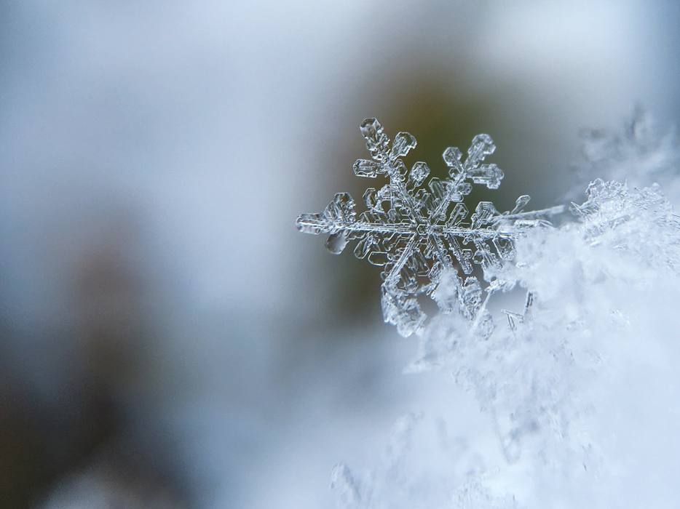
We usually went outside in morning in that much cold. Do breakfast there and play with snow. All this have the good taste whenever I remember it.
These memories came in my mind whenever I close my eyes. There is a smile on my face when I glimpse these moments.

Slide 7
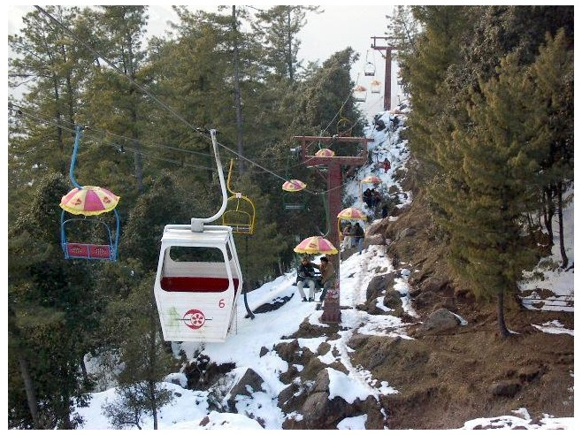
We go outside and made plan to enjoy. Our parents brought us to mall road. There we took lifts and made gossips with family. We took a camera and made many photos there.

Slide 8
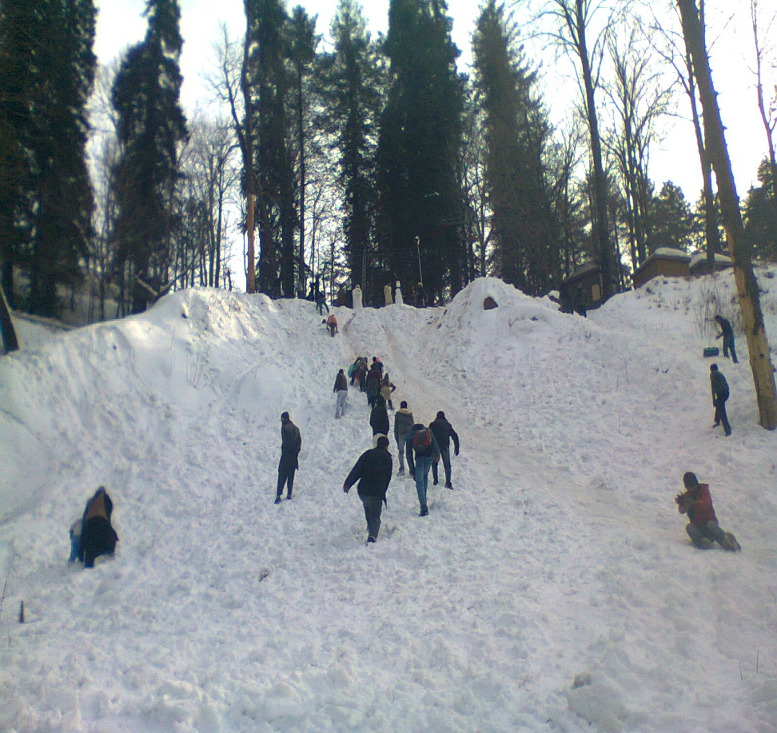
There were mountains near our ansestor’s villa. We usually went there and do some fun. We enjoyed by throwing ice balls on one another. We also made some pictures to recall these precious moments.

Slide 9
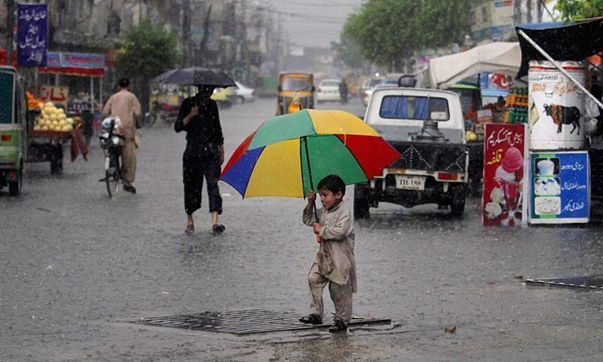
We then go to mall road to do some shopings for our beloved ones. Firstly, we went there by our own car . It started raining there. Our parents advised us to go back but we do a lot of fun there even if we cannot buy anything

Slide 10
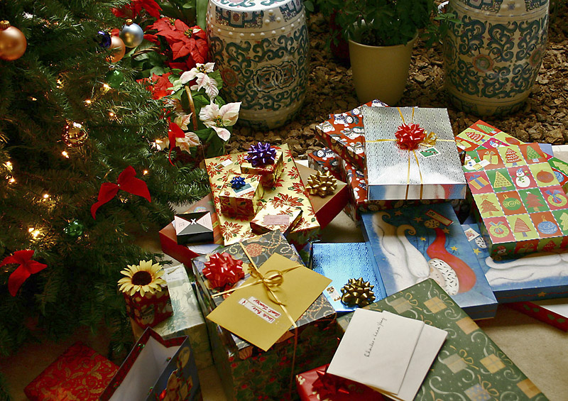
The next day, we again went to mall road . That day we bought some things and show our love for our friends and family. I bought many gifts and choclates for my siblings and friends.

Slide 11
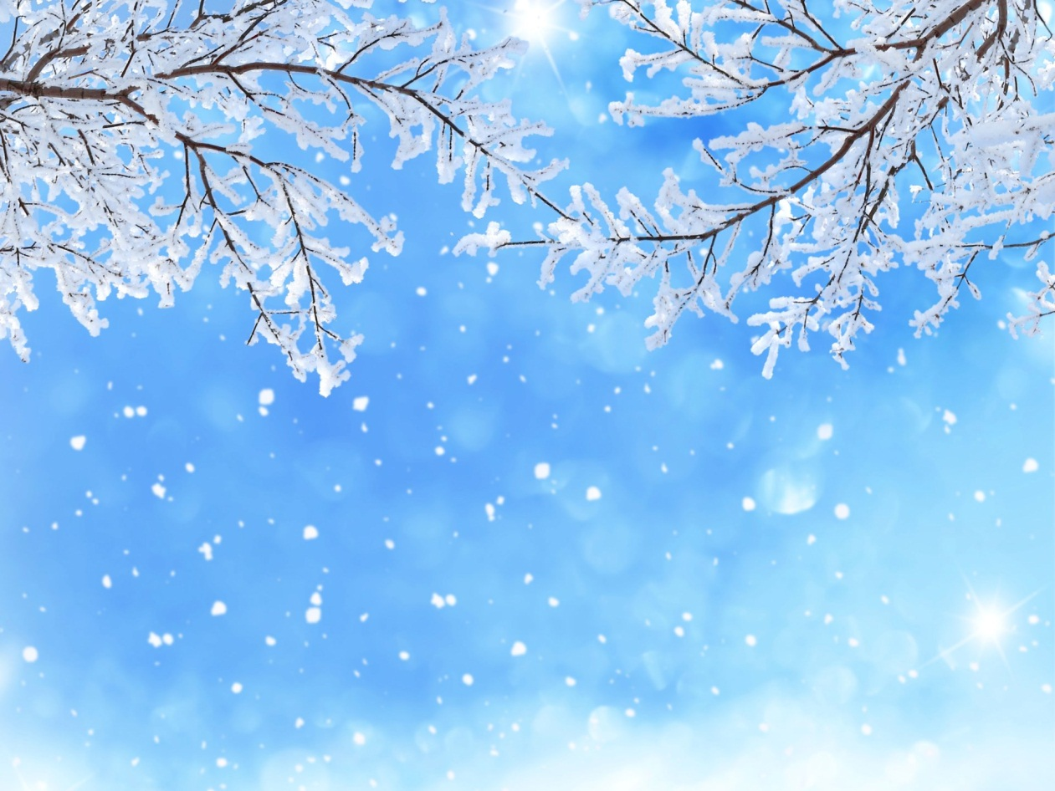
I cannot forget these beautiful days from my mind’s book. I wish we could go again in muree to make fun with my family.

Slide 12
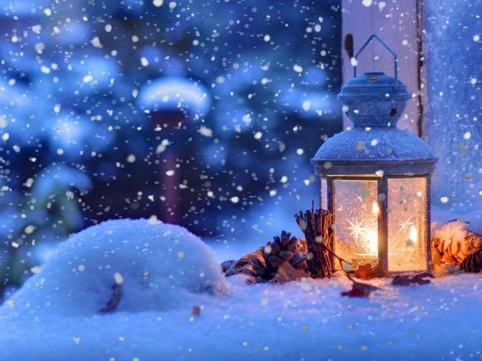
As our vacations have came to an end, we have to go back to home. So me and my family return to home late at night. Though, I came to sargodha, but my heart and mind would always be there.

Slide 13
Thank you.

